Slide 1
Drug Recommendation System based on Sentiment Analysis of Drug Reviews
Guidename: Dr.K.Valarmathi ME,PhD
PROFESSOR
TEAM MEMBERS
TEJASWINI P-211418104290
VIDHYASREE C-211418104308
VILASINI G-211418104310

Slide 2
INTRODUCTION
Since the number of coronavirus cases are increasing tremendously, the nations are facing a shortage of doctors, mainly in rural areas when compared to urban areas. Clinical blunders are regular nowadays.
Over 40% medicine, doctors make mistakes while prescribing since they are referred by their knowledge. Selecting the top-level medication is important for patients who need doctors with wide-based information about microscopic organisms, antibacterial medications, and patients .
Every day a new study comes up with more drugs, tests. Due to the development of the web and the web-based technology, item reviews have become an important factor for acquiring items. Individual have become adjusted to analyze reviews and websites before selecting a choice to buy a thing.
Pew American Research center survey directed in 2013 , 60% of grown-ups searched online for health- related subjects, and 35% of users looked for diagnosing health conditions on the web . A medication recommender framework is needed with a goal that it can assist specialists or doctors and help patients to build their knowledge of drugs on specific health issues. A recommender framework is a system that provides an item to the user, dependent on their advantage, need and necessity.

Slide 3
INTRODUCTION(cont….)
These frameworks employ the customers surveys to break down their sentiment and suggest a recommendation for their exact need. In the drug recommender system, medicine is offered on a specific condition dependent on patient reviews using sentiment analysis and feature engineering.
Sentiment analysis is a progression of strategies, methods, and tools for distinguishing and extracting emotional data . examination work separated into five segments: Introduction area which provides a short insight concerning the need of this research, Related works segment gives a concise insight regarding the previous examinations on this area of study, Methodology part includes the methods adopted in this research, The Result segment evaluates applied model results using various metrics, the Discussion section contains limitations of the framework.

Slide 4
LITERATURE SURVEY
SOURCE | TITLE OF PROJECT | ALGORITHM | FINDINGS
Satvik Garg | Drug Recommendation System based on Sentiment Analysis of Drug Reviews using Machine Learning | Linear SVC | In this study, medicine recommendation system that uses patient reviews to predict sentiment using various vectorization processes such as Bow, TF-IDF, Word2Vec, and Manual Feature Analysis, which can help different classification algorithms recommend the best drug for a given disease.
Julie Polisena , Martina Andellini, Piergiorgio Salerno , Simone Borsci, Leandro Pecchia , Ernesto Iadanza. | Case Studies on the Use of Sentiment Analysis to Assess the Effectiveness Safety of Health Technologies: A Scoping Review. | Random Forest Classifier | A health technology assessment is a multidisciplinary strategy to systematically and thoroughly evaluating medical and social issues associated to the usage of a health technology.
Nur Sysfiqah Mohd Nafis, Suryanti Awang | An Enhanced Hybrid Feature Selection Technique Using Term Frequency-Inverse Document Frequency and Support Vector Machine- Recursive Feature Elimination for Sentiment Classification. | TF-IDF,SVM | This research provides an improved hybrid feature selection technique based on machine learning approaches to improve sentiment categorization.
Kashif Ayyub, Saqib, Ehsan Ullah Munir, Muhammad Wasif Nisar, Momna Abbasi. | Exploring Diverse Features for Sentiment Quantification Using Machine Learning Algorithms” | Long short-term memory | Sentiment analysis is a research topic that involves categorising these views, opinions, and remarks.
Azwa Abdul Aziz, Andrew Starkey. | Predicting Supervise Machine Learning Performances for Sentiment analysis Using Contextual-Based Approaches. | Supervised Machine Learning(SML) | The use of supervised machine learning (SML), a method that employs datasets with predetermined class labels based on mathematical learning from a training dataset, is one of the most popular approaches for SA.

Slide 5
SOURCE | TITLE OF PROJECT | ALGORITHM | FINDINGS
Oladapo Oyebode, Felwah Alqahtani, Rita Orji. | Using Machine Learning and Thematic Analysis Methods to Evaluat Mental Health Apps Based on User Reviews. | SML and FI-score | The top performing classifier was then used to predict the sentiment polarity of reviews, with an F1-score of 89.42 percent.
Farkhund Iqbal, Jahanzeb Maqbool Hashmi, Benjamin C.M.Fung, Rabia Batool, Asad Masood Khattak, Saiqa. | A Hybrid Framework for Sentiment Analysis Using Genetic Algorithm Based Feature Reduction. | Genetic Algorithm | This research presents an integrated framework for improving accuracy and scalability by bridging the gap between lexicon-based and machine learning approaches.
Mei-Hua Chen, Wei-Fan Chen, Lun-Wei Ku. | Application of Sentiment Analysis to Language Learning. | RESOLVE | We built RESOLVE, a context-aware emotion synonym suggesting system for educational purposes, to achieve this goal.
Monika Fedorova , Daniela Perdukova , Zdenko Pirnik, Viliam Fedak Ondrej Sukel , Padmanaban Sanjeevikumar. | “Fuzzy system as a promising tool for drugs Selection in medical practise”. | Fuzzy Approach | The fuzzy method to healthcare database analysis is a new tool for generating information that may be used in the ultimate decision-making process of drug selection in medical practise for a defined polymorbid group of patients.
V. Goel, A. K. Gupta ,N. Kumar | “Sentiment Analysis of Multilingual Twitter Data using Natural Language Processing”. | Naive Bayes and Recurrent Neural Network | Naive Bayes and Recurrent Neural Networks were used to accomplish multilingual sentiment analysis in this study (RNN). The data show that RNN outperformed Naive Bayes 95.34 percent of the time .

Slide 6
PROBLEM STATEMENT
Nowadays individuals are being affected by various diseases for which they do noy get proper treatment at the right time. There are inaccessibility of legitimate clinical resources at its peak, like the shortage of specialists and healthcare workers, lack of proper equipment and medicines etc.
The entire medical society is in distress, resulting in individual’s demise. The number of doctors cannot be expanded in a short span of time.
Due to this the individuals started taking medicines independently without consulting doctor.
This project is to present a drug recommender system that can reduce the specialists work load.
The drug recommender system provides medicine based on patient reviews using sentiment analysis and feature engineering.

Slide 7
DEVELOPMENT ENVIRONMENT
HARDWARE REQUIREMENTS
2GB RAM
Touchpad/Mouse
3GB Disk Space
SOFTWARE REQUIREMENTS
Debian Linux OS/Windows OS Atom
Coding Language : Python 3.8
Browser
Terminal MySQL
Sqlite Studio Django, HTML, CSS, Bootstrap, Javascript

Slide 8
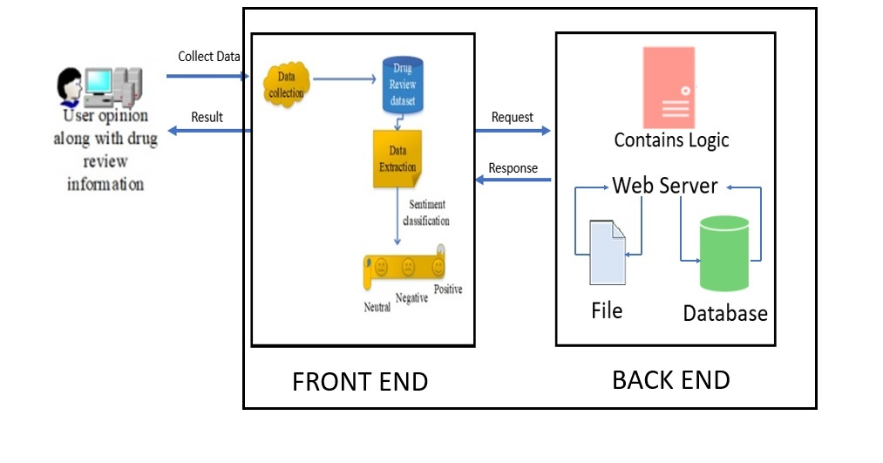
ARCHITECTURE DIAGRAM

Slide 9
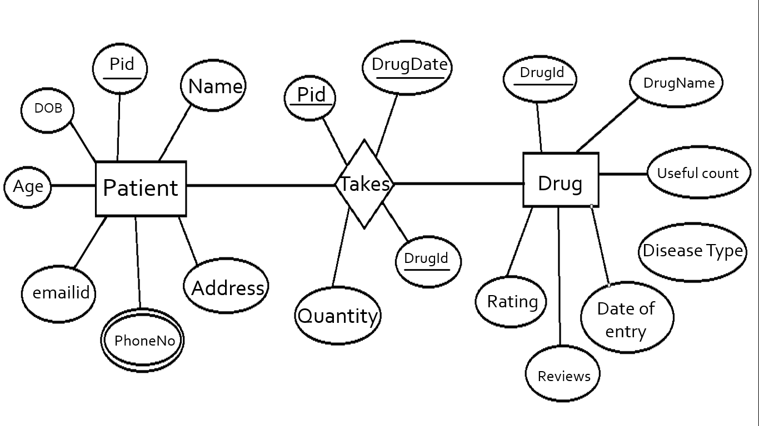
SYSTEM DESIGN
ER DIAGRAM

Slide 10
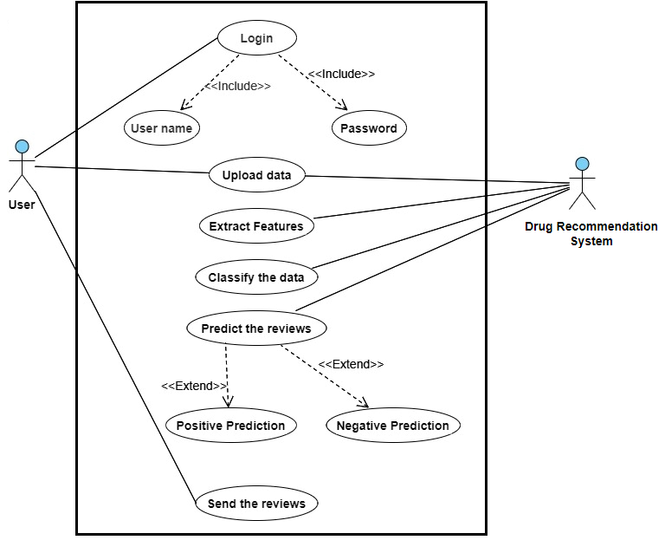
UML DIAGRAMS
USECASE DIAGRAM

Slide 11
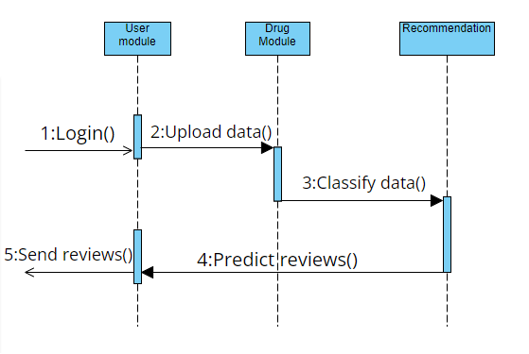
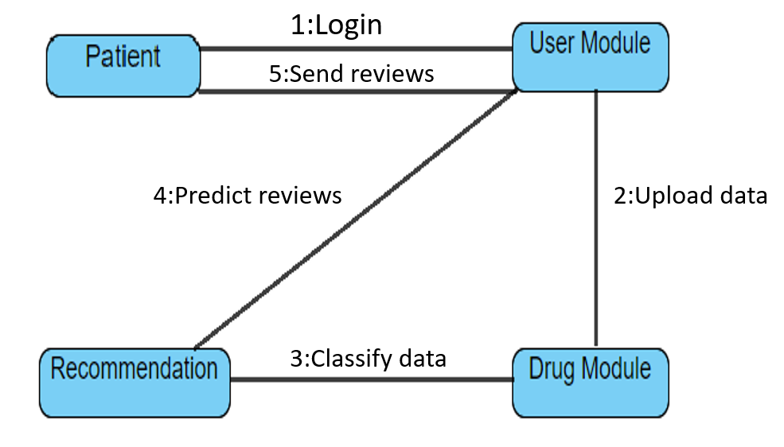
COLLABORATION DIAGRAM
SEQUENCE DIAGRAM

Slide 12
DATA FLOW DIAGRAM
LEVEL 0 DFD DIAGRAM
Admin
DRUG RECOMMENDATION SYSTEM
Patient
LEVEL 1 DFD DIAGRAM
Admin
DRUG RECOMMENDATION SYSTEM
Patient
User Module
Drug Module
Recommendation
LEVEL 1 DFD DIAGRAM
Admin
DRUG RECOMMENDATION SYSTEM
Patient
User Module
Recommendation
Drug Module
Uploading data
Classification of data
Reviews prediction
Feedback

Slide 13
MODULAR DESCRIPTION
Name of the module -1: REGISTRATION
Description
This module helps the new users to get registered in the drug recommender system
The patients can get registered by their username and password.
A unique ID is generated for each patient by the system after they get registered.
Name of the module -2: PATIENT MODULE
Description
After registration the patients can login into the system using their unique username and password.
The patient needs to upload their drugname ,reviews and type of disease for training or testing.

Slide 14
Name of the module -3: DRUG MODULE
Description
The system classifies the data uploaded by patients into six attributes : name of drug, review of patient, condition of patients, useful count, date of review entry and10-star patient rating determining overall patient contentment.
Name of the module -4: RECOMMENDATION
Description
The recommendation module helps in review prediction.
Based on the sentimental reviews uploaded by the patients, the drug can be predicted as positive or negative.
The system can provide prediction for multiple patients at the same time.
Name of the module -5: ANALYSIS
Description
This module provide feedback to the patients.
Analysis module helps in providing prediction for different drugs and accuracy plot.

Slide 15
SYSTEM TESTING
UNIT TESTING
Unit Testing involves the design of test cases that validate that the internal program logic is functioning properly, and that program inputs produce valid outputs. All decision branches and internal code flow should be validated. Unit tests perform basic tests at component level and test a specific business process, application and / or system configuration. Unit tests ensure that each unique path of a business process performs accurately to the documented specifications and contains clearly defined inputs and expected results. Unit testing is usually conducted as part of the combined code and unit test phase of the software life cycle ,although it is not uncommon for coding and unit testing to be conducted as to distinct phases.
INTEGRATION TESTING
Integration tests are designed to test integrated software components to determine if they actually run as one program . Testing is event driven and is more concerned with the basic outcome of screens or fields. Integration tests demonstrate that although the components were individually satisfaction, as shown by successfully unit testing , the combination of components is correct and consistent. Intregration testing is specifically aimed at exposing the problems that arise from the components. Software integration testing is the incremental integration testing of two or more integrated software components on a single platform to produce failures caused by interface defects. The task of the integration test is to check that components or software applications.

Slide 16
RESULT
Depending on the user's star rating, each review was categorised as positive or negative. Positive ratings range from six to ten stars, while negative ratings range from one to five stars. All of the algorithms had similar findings, ranging from 89 to 91 percent accuracy. The LGBM model has the best accuracy of 91 percent. After analysing all of the models, the combined model predictions of Perceptron (Bow), LinearSVC (TFIDF), LGBM (Word2Vec), and Random Forest (Manual Features) were incorporated. The major goal is to ensure that each of the four models accurately classifies the recommended top medications.

Slide 17
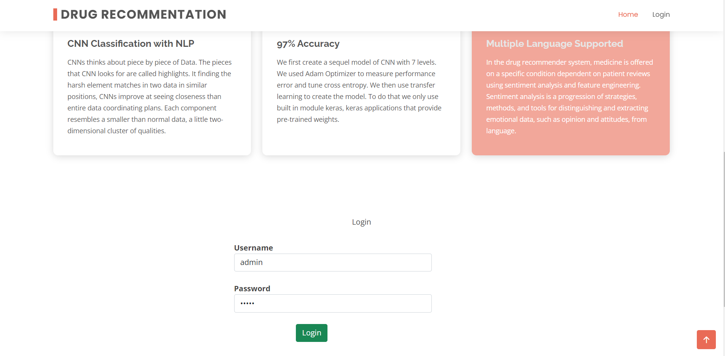
LOGIN PAGE
SAMPLE SCREENS

Slide 18
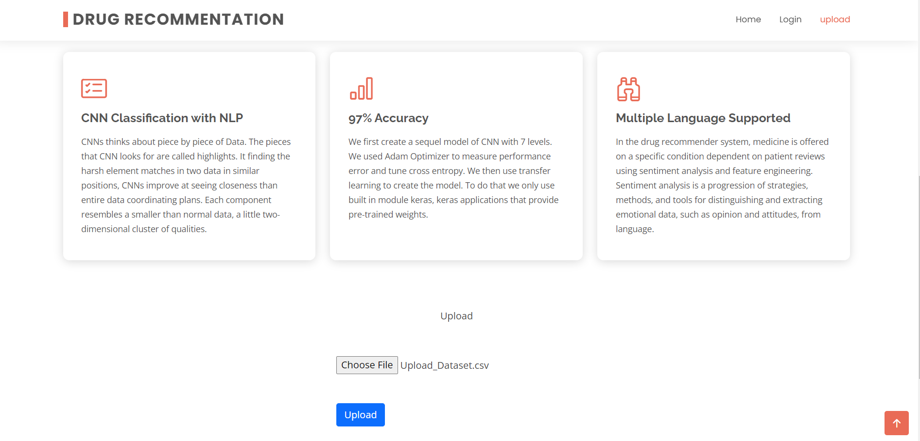
UPLOAD PAGE

Slide 19
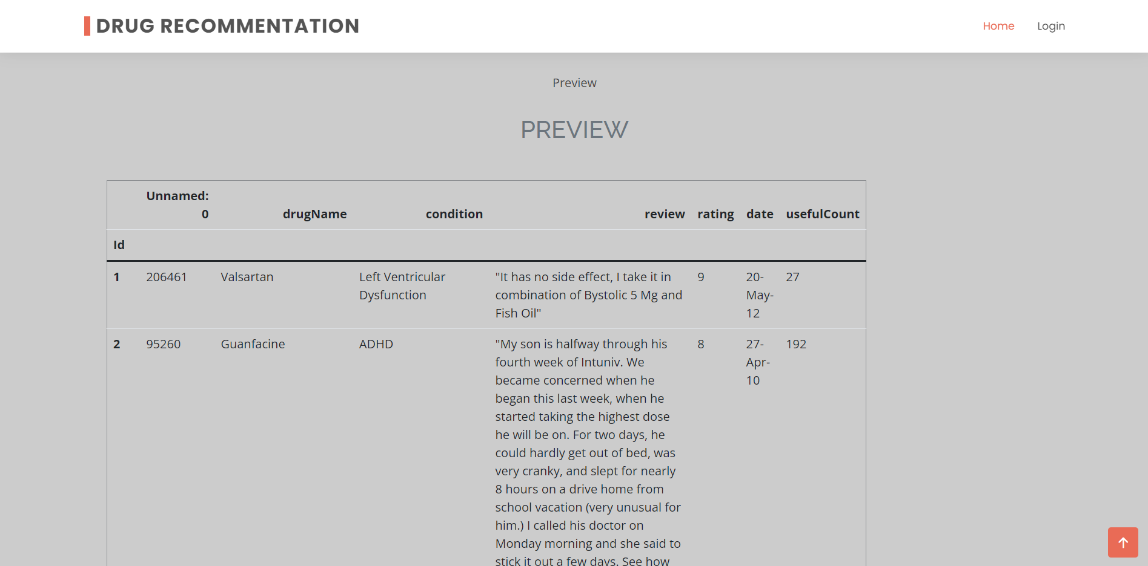
PREVIEW

Slide 20
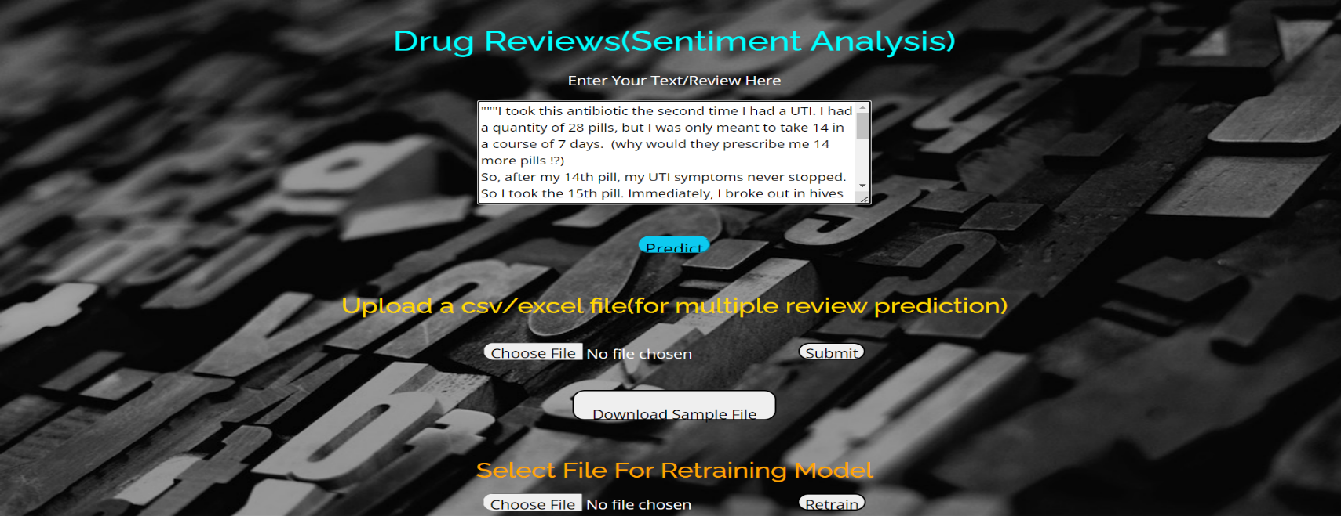

PREDICTION
MULTIPLE PREDICTION

Slide 21
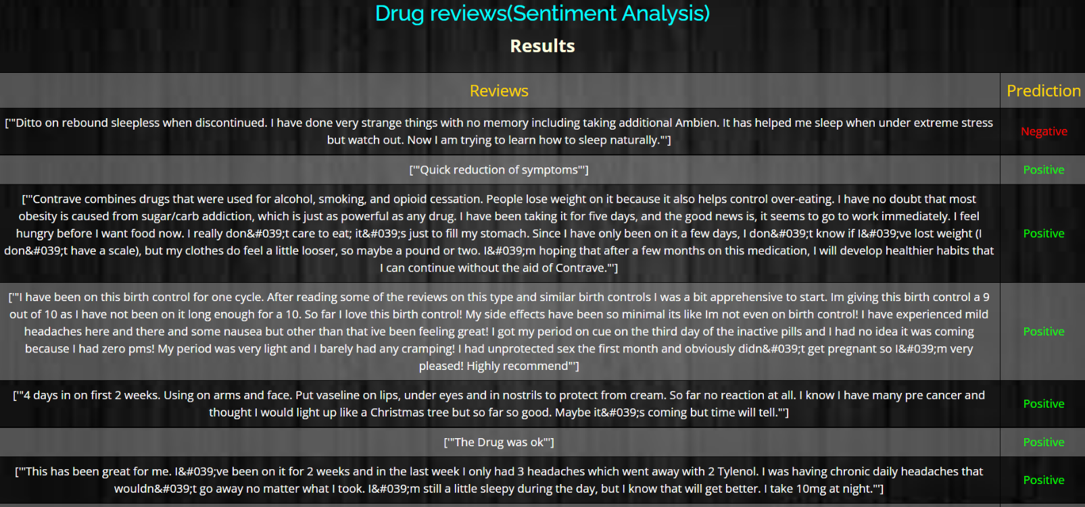
PREDICTION RESULTS

Slide 22
CONCLUSION
A novel unified deep learning-based framework for Drug recommender systems was proposed. The main contributions of the paper include:
Deep Drug unifies the candidate generation, ranking, community detection, matrix factorization, review miner modules.
The proposed framework is generic and with a few manipulations, can be used for different scenarios other than Drug recommendation. Adding a new information source to the framework is straightforward. For example, one can sample some number of frames from each Drug, feed them to a convolutional neural network and add the final feature map to the representation vector of the Drug.

Slide 23
REFERENCES
1. Satvik Garg, (2021), “Drug Recommendation System based on Sentiment Analysis of Drug Reviews using Machine Learning”.
2. Julie Polisena , Martina Andellini, Piergiorgio Salerno , Simone Borsci, Leandro Pecchia , Ernesto Iadanza, (2021), “Case Studies on the Use of Sentiment Analysis to Assess the Effectiveness Safety of Health Technologies: A Scoping Review”.
3. Nur Sysfiqah Mohd Nafis, Suryanti Awang, (2021), “An Enhanced Hybrid Feature Selection Technique Using Term Frequency-Inverse Document Frequency and Support Vector Machine- Recursive Feature Elimination for Sentiment Classification”.
4. Kashif Ayyub, Saqib, Ehsan Ullah Munir, Muhammad Wasif Nisar, Momna Abbasi ,(2020),” Exploring Diverse Features for Sentiment Quantification Using Machine Learning Algorithms”.
5. Azwa Abdul Aziz, Andrew Starkey, (2020) ,” Predicting Supervise Machine Learning Performances for Sentiment analysis Using Contextual-Based Approaches”.
6. Oladapo Oyebode, Felwah Alqahtani, Rita Orji, (2020), “Using Machine Learning and Thematic Analysis Methods to Evaluat Mental Health Apps Based on User Reviews”.
7. Farkhund Iqbal, Jahanzeb Maqbool Hashmi, Benjamin C.M.Fung, Rabia Batool, Asad Masood Khattak, Saiqa, (2019), “A Hybrid Framework for Sentiment Analysis Using Genetic Algorithm Based Feature Reduction”.
8. Mei-Hua Chen, Wei-Fan Chen, Lun-Wei Ku, (2019), “Application of Sentiment Analysis to Language Learning”.

Slide 24
9. Monika Fedorova , Daniela Perdukova , Zdenko Pirnik, Viliam Fedak Ondrej Sukel , Padmanaban Sanjeevikumar, (2019), “Fuzzy system as a promising tool for drugs Selection in medical practise”.
10. V. Goel, A. K. Gupta ,N. Kumar, (2019), “Sentiment Analysis of Multilingual Twitter Data using Natural Language Processing”.
11. Atif &Peng , Dafang & Hassan,Zhang, Limei , Mohammad & Alamri, Yin & Zhang, et al. (2014), “CADRE: Cloud-Assisted Drug Recommendation Service for Online Pharmacies. Mobile Networks and Applications”, pp.348-355.
12. K. W. Bowyer, L. O. Hall, N. V. Chawla and W. P. Kegelmeyer, (2011), “SMOTE: Synthetic Minority Over-sampling Technique”, Journal Of Artificial Intelligence Research, Vol.16, pp. 321-357.
13. Chonghui Guo, Chuanren Liu, Hui Xiong, Leilei Sun and Yanming Xie et al. (2016), “Data-driven Automatic Treatment Regimen Development and Recommendation”, pp.1865–1874.
14. M. Emmanuel and T. N. Tekade, (2016),” Probabilistic aspect mining approach for interpretation and evaluation of drug reviews” , International Conference on Signal Processing, Communication, Power and Embedded System (SCOPES), pp. 1471-1476.
15. X. Jiang and Y. Bao,(2016) , ”An intelligent medicine recommender system framework”, IEEE 11th Conference on Industrial Electronics and Applications (ICIEA), pp. 1383-1388.
16. J. Li, H. Xu, X. He, J. Deng and X. Sun et al. (2016), “Tweet modeling with LSTM recurrent neural networks for hashtag recommendation”, International Joint Conference on Neural Networks (IJCNN),pp.1570-1577.
17. C., Nikolaidis ,Doulaverakis, GalenOWL , G., Kleontas, et al. (2012) , “Ontologybased drug recommendations discovery”.

Slide 25
18. Omer Levy and Yoav Goldberg , (2014),“word2vec Explained: deriving Mikolov et al.’s negative-sampling word-embedding method”.
19. Zhang, Yin & Jin, Rong & Zhou, Zhi-Hua,(2010), “Understanding bag-of-words model: A statistical framework. International Journal of Machine Learning and Cybernetics”.
20. J. Ramos et al., (2003), “Using tf-idf to determine word relevance in document queries”, In Proceedings of the first instructional conference on machinelearning, pp.133–142.
21. Duggan, Fox, Maeve, Susannah, et al.” Health online (2013) Pew Research Internet Project Report.
22. Burkle CM , , Lanier WL ,Wittich CM, et al.(2014)“Medication errors: an overview for clinicians”, Vol. 89, pp.1116-25.
23. CHEN, M. R., WANG, H. F, et al. (2013), “The reason and prevention of hospital medication errors. Practical Journal of Clinical Medicine”, Vol. 4. 50
24. BartlettJG, Dowell SF, Fine MJ, Mandell LA, File TM Jr, Musher DM, et al.(2000), “Practice guidelines for the management of community-acquired pneumonia in adults. Infectious Diseases Society of America”. Vol.31, pp.347-82. 25. V. Goel, A. K. Gupta ,N. Kumar et al. year 2018,”Sentiment Analysis of Multilingual Twitter Data using Natural Language Processing” ,8th International Conference on Communication Systems and Network Technologies (CSNT), Bhopal, India. Page: 208-212..

